Slide 1

Software Quality Engineering
BSSE-VI
Sumaira Nazir
Assistant Professor
Department of Software Engineering
National University of Modern Languages, Islamabad

Slide 2
Process Standards
CMM

Slide 3
Process Standards
Capability Maturity Model
The Capability Maturity Model (CMM) is a development model created in 1986

Slide 4
Capability Maturity Model
Maturity Model
A maturity can be viewed as a set of structured levels that describe how well the behaviors, practices and processes of an organization can reliably and sustainably produce required outcomes.
A maturity model can be used as a benchmark for comparison and as an aid to understanding - for example, for comparative assessment of different organizations where there is something in common that can be used as a basis for comparison. In the case of the CMM, for example, the basis for comparison would be the organizations' software development processes.

Slide 5
Capability Maturity Model-Structure
The model involves five aspects:
Maturity Levels: a 5-level process maturity continuum - where the uppermost (5th) level is a notional ideal state where processes would be systematically managed by a combination of process optimization and continuous process improvement.
Key Process Areas: a Key Process Area identifies a cluster of related activities that, when performed together, achieve a set of goals considered important.
Goals: the goals of a key process area summarize the states that must exist for that key process area to have been implemented in an effective and lasting way. The extent to which the goals have been accomplished is an indicator of how much capability the organization has established at that maturity level. The goals signify the scope, boundaries, and intent of each key process area.
Common Features: common features include practices that implement and institutionalize a key process area. There are five types of common features: commitment to perform, ability to perform, activities performed, measurement and analysis, and verifying implementation.
Key Practices: The key practices describe the elements of infrastructure and practice that contribute most effectively to the implementation and institutionalization of the area.

Slide 6
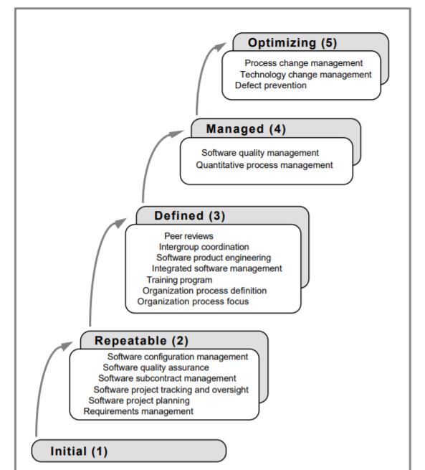
KPA

Slide 7
Levels
Level 1 - Initial
It is characteristic of processes at this level that they are (typically) undocumented and in a state of dynamic change, tending to be driven in an ad hoc, uncontrolled and reactive manner by users or events. This provides a chaotic or unstable environment for the processes. (Example - a surgeon performing a new operation a small number of times - the levels of negative outcome are not known).
Level 2 - Repeatable
It is characteristic of this level of maturity that some processes are repeatable, possibly with consistent results. Process discipline is unlikely to be rigorous, but where it exists it may help to ensure that existing processes are maintained during times of stress.

Slide 8
Levels
Level 3 - Defined
It is characteristic of processes at this level that there are sets of defined and documented standard processes established and subject to some degree of improvement over time. These standard processes are in place. The processes may not have been systematically or repeatedly used - sufficient for the users to become competent or the process to be validated in a range of situations. This could be considered a developmental stage - with use in a wider range of conditions and user competence development the process can develop to next level of maturity.

Slide 9
Levels
Level 4 - Managed (Capable)
It is characteristic of processes at this level that, using process metrics, effective achievement of the process objectives can be evidenced across a range of operational conditions. The suitability of the process in multiple environments has been tested and the process refined and adapted. Process users have experienced the process in multiple and varied conditions, and are able to demonstrate competence. The process maturity enables adaptions to particular projects without measurable losses of quality or deviations from specifications. Process Capability is established from this level. (Example - surgeon performing an operation hundreds of times with levels of negative outcome approaching zero).

Slide 10
Levels
Level 5 - Optimizing (Efficient)
It is a characteristic of processes at this level that the focus is on continually improving process performance through both incremental and innovative technological changes/improvements. At maturity level 5, processes are concerned with addressing statistical common causes of process variation and changing the process

Slide 11
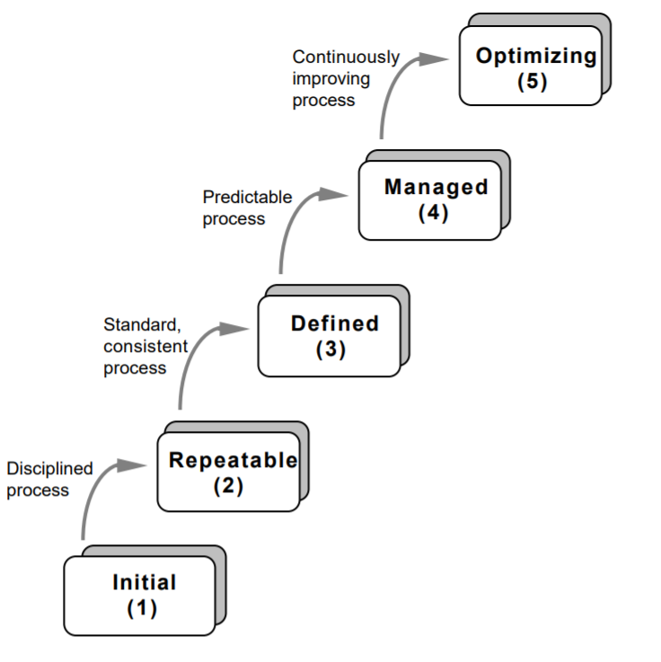
CMM

